Slide 1
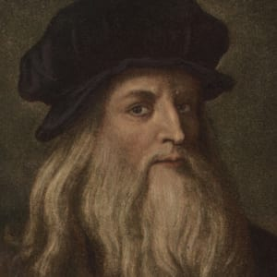
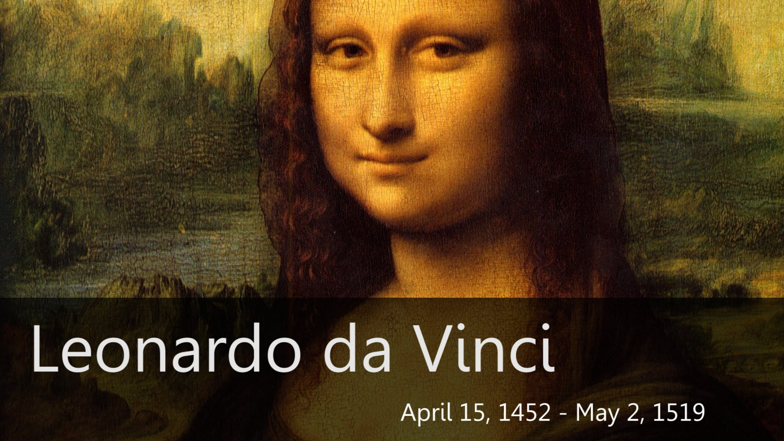
Modern da Vinci!

Slide 2
Outline
Motivation
Objectives
Working phases
Challenges
Future Work
Demo
Notes:
<number>

Slide 3
Outline
Motivation
Notes:
<number>

Slide 4
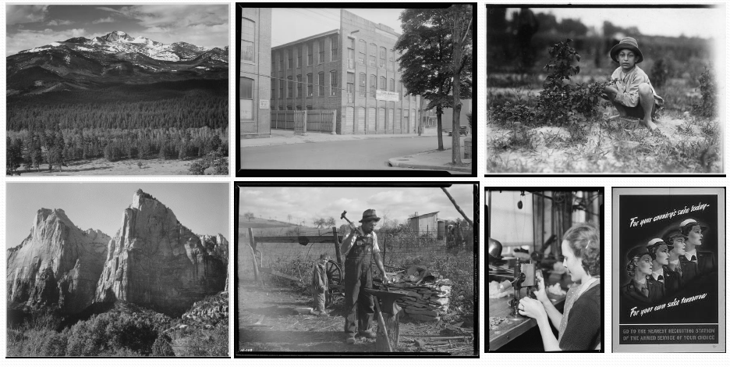
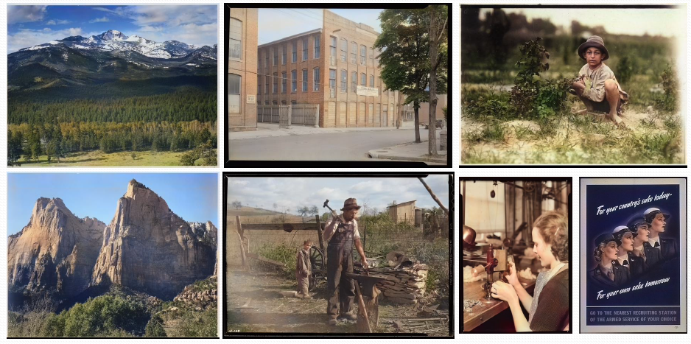
Motivation
Notes:
<number>

Slide 5
Outline
Motivation
Objectives
Notes:
<number>

Slide 6
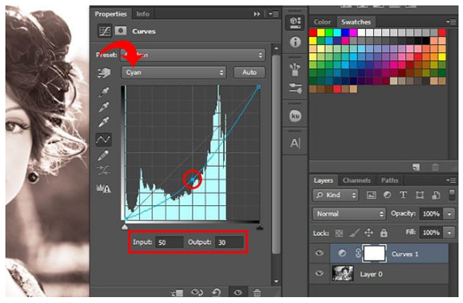
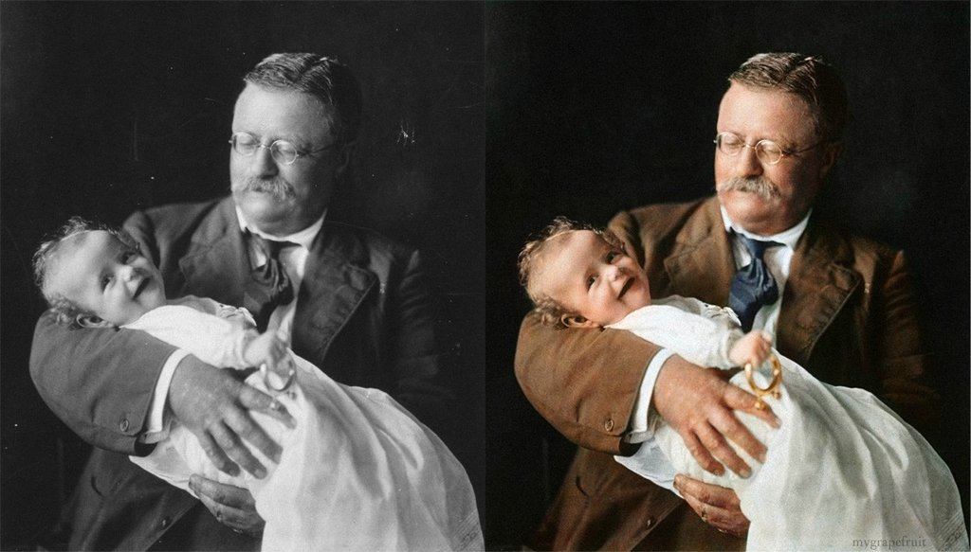
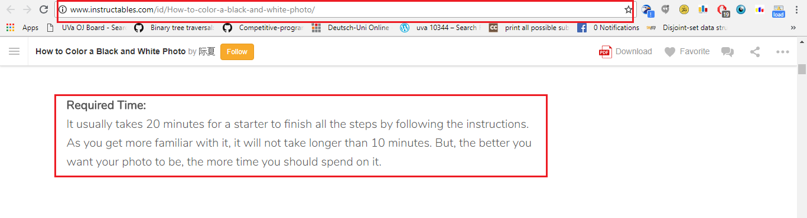
Objectives
Colouring photos could bring you a lot of fun to your daily life. Just imagine if you coloured your grandma’s old photo and showed it to your family, how surprised and happy they would be.
Colouring a picture with Photoshop is a so exhausting process.
Notes:
<number>

Slide 7
Outline
Motivation
Objectives
Working phases
Notes:
<number>

Slide 8
Working phases
Building Datasets
Model Building and Training
Model Testing and Validation
Model Interface
Notes:
<number>

Slide 9
Working phases
Building Datasets
Notes:
<number>

Slide 10
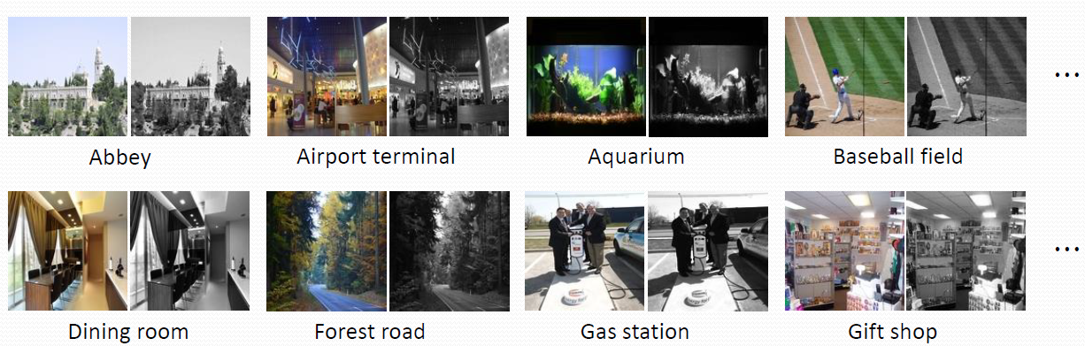
Phases Overview | Building Datasets
MIT Places Scence Dataset [Zhou+ 2014]
2.3 Million training images 256 x 256 RGB [24GB]
Notes:
<number>

Slide 11
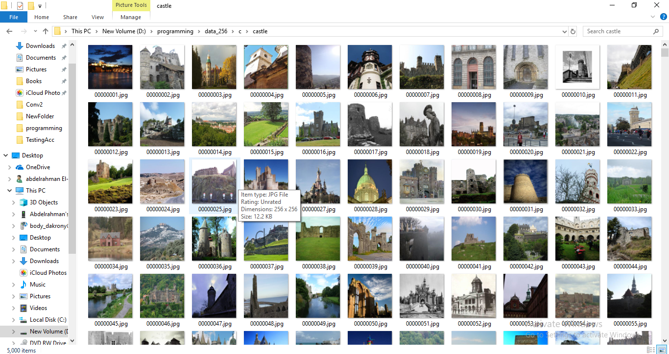
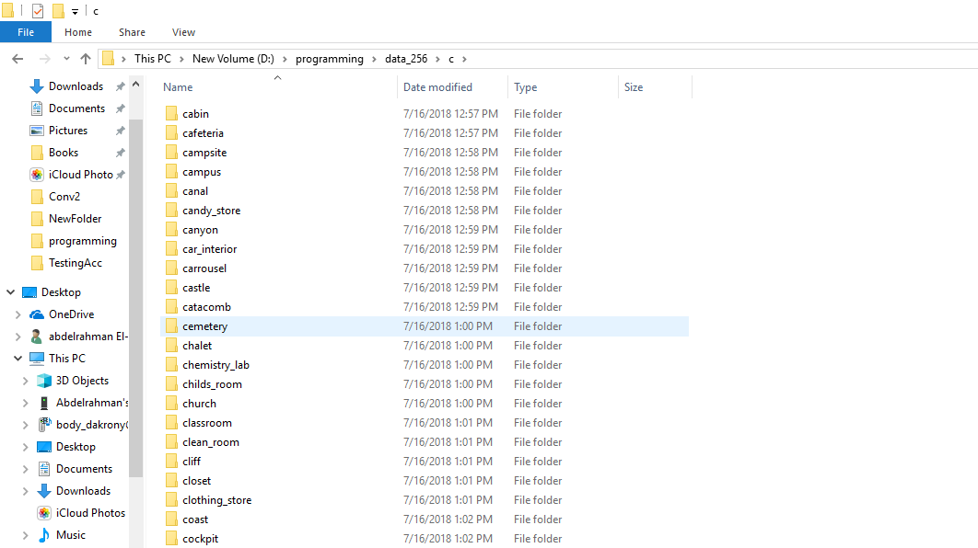
Phases Overview | Building Datasets
MIT Places Scence Dataset [ Landscapes – Sea – Roads – Gardens ]
Used 15k Pictures
Notes:
<number>

Slide 12
Working phases
Building Datasets
Model Building and Training
Notes:
<number>

Slide 13
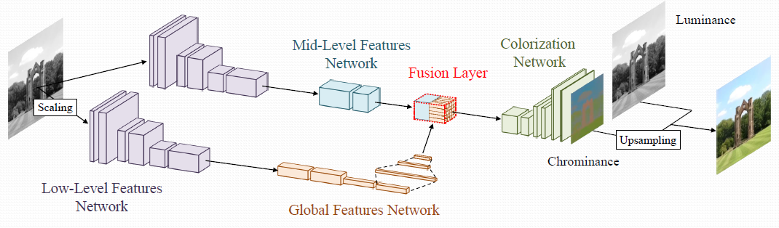
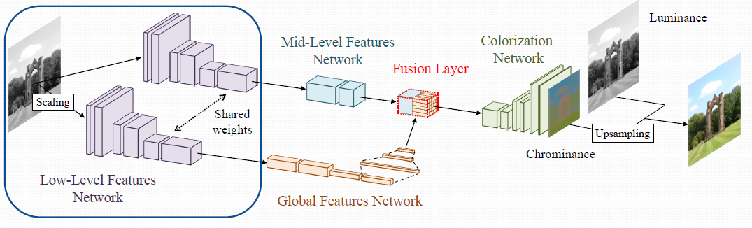
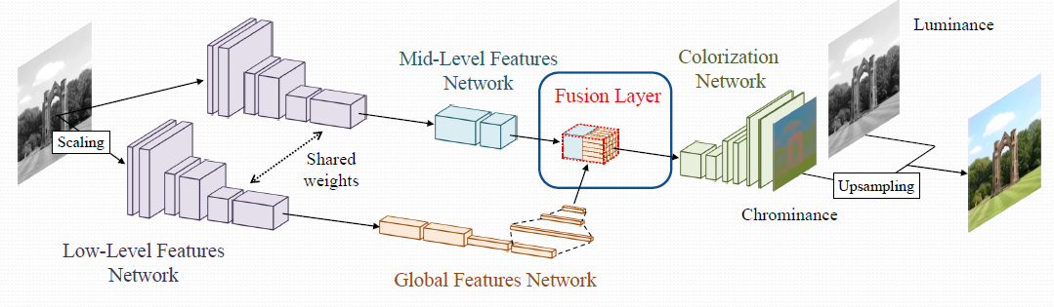
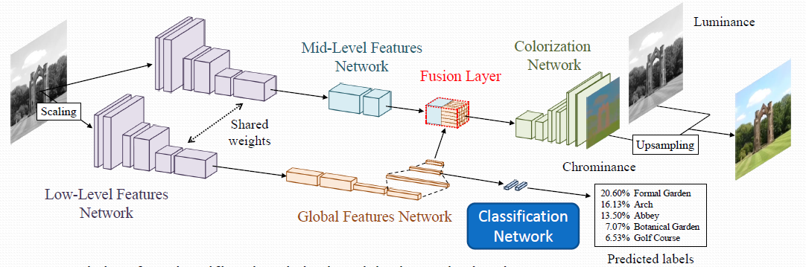
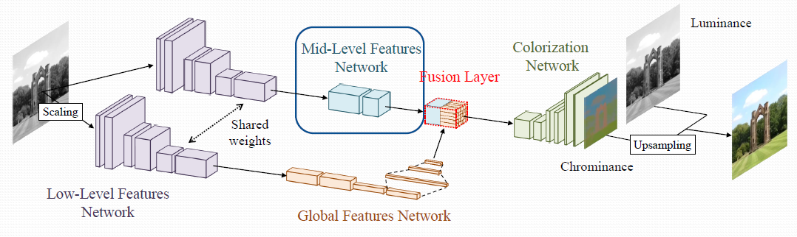
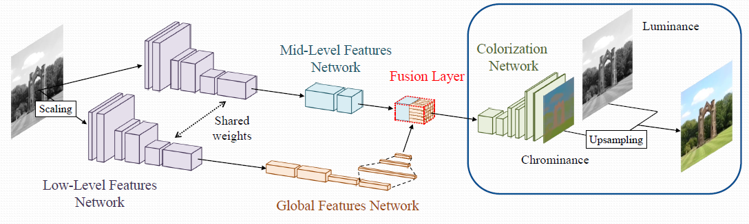
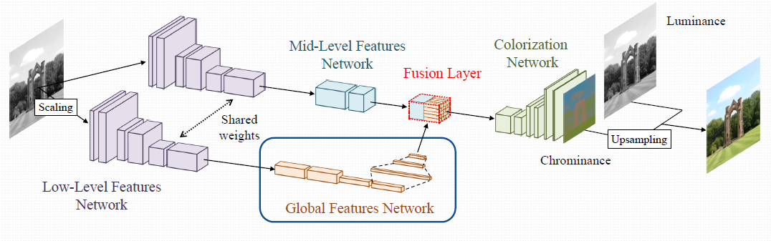
Phases Overview | Building Model
[Let there be Color 2016] [end2end model]
Notes:
<number>

Slide 14
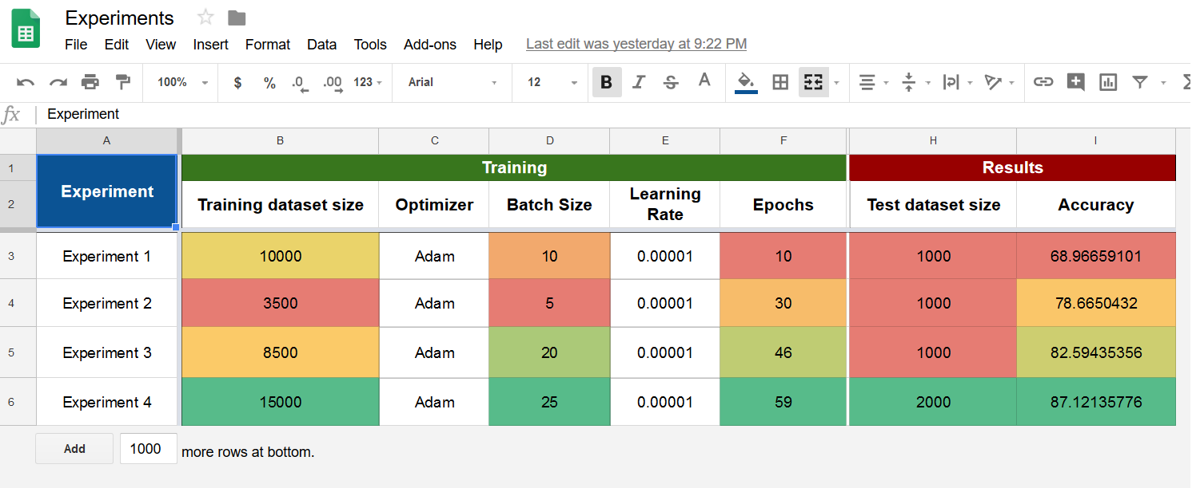
Phases Overview | Model Training
Experiments
Notes:
It took average 1:45 hours to train one epoch.
<number>

Slide 15
Working phases
Building Datasets
Model Building and Training
Model Testing and Validation
Notes:
<number>

Slide 16
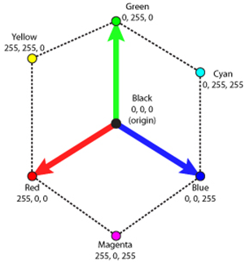
Phases Overview | Testing Model
Calculating the accuracy is done by calculating the Euclidean distance between the predicted and the ground truth
Every color channel have to be represented as
a dimension
Notes:
<number>

Slide 17
Working phases
Building Datasets
Model Building and Training
Model Testing and Validation
Model Interface
Notes:
<number>

Slide 18
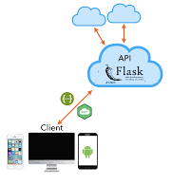
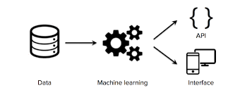
Phases Overview | Interface
We Built a web application With Python-Flask and Microservice Architecture
Model API; so it can be accessible from any device.
Notes:
<number>

Slide 19
Outline
Motivation
Objectives
Working phases
Challenges
Notes:
<number>

Slide 20
Challenges & Lessons Learnt
Training the model was hard because of limited hardware supply
Working with new packages / technologies we are not familiar with like tensorflow , opencv , PIL Image
Taking the Machine learning model to production, using new technologies (Microservice architecture, Flask API)
Notes:
Mention Alex Machine, Kaggle machine …
<number>

Slide 21
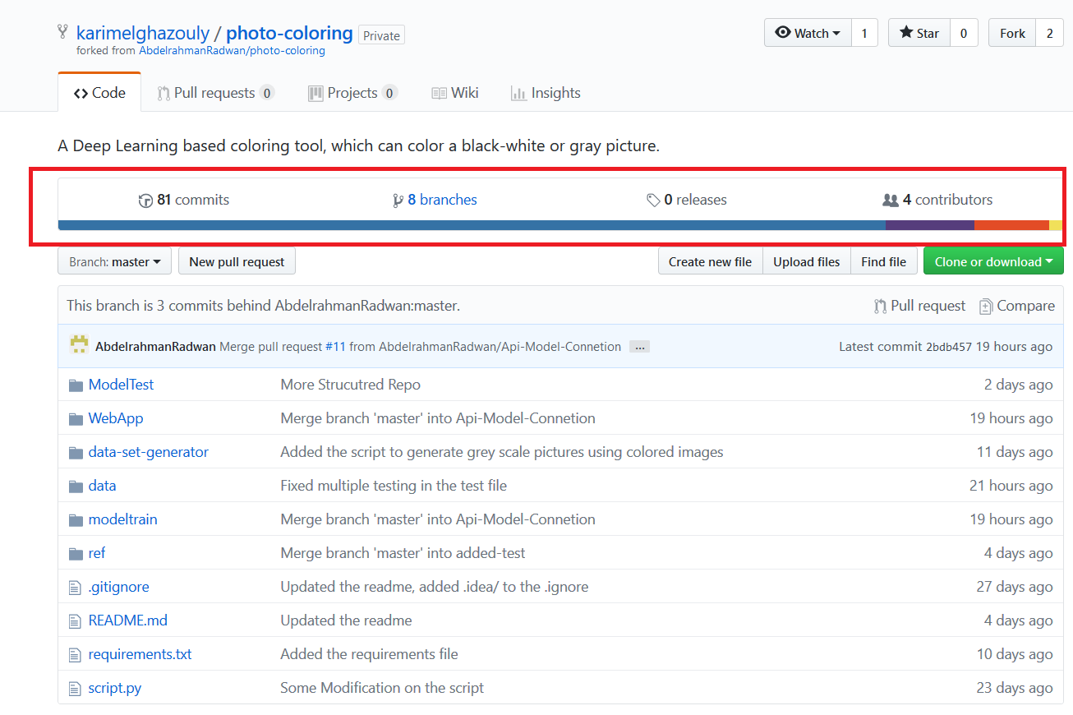
Challenges & Lessons Learnt
Working on Version Control Systems and Organize our project as Open source
Notes:
Mention Alex Machine, Kaggle machine …
<number>

Slide 22
Outline
Motivation
Objectives
Working phases
Challenges
Future Work
Notes:
<number>

Slide 23
Future Work
Training, Training and more Training
Train on more data clusters
Extend the project to be able to colorize Videos
Notes:
<number>

Slide 24
Outline
Motivation
Objectives
Working phases
Challenges
Future Work
Demo
Notes:
<number>

Slide 25
Demo!
Notes:
<number>

Slide 26
Questions?
Notes:
<number>

Slide 27
Thank You!
Notes:
<number>

